Slide 1

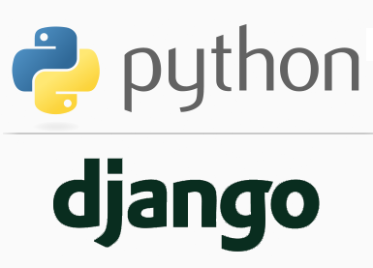
FULL STACK WEB DEVELOPMENT WITH DJANGO
Lecture 36

Slide 2

Today’s Agenda
Developing Our Django App
Accessing Session Object
Operating On Session Data
Where Is Session Data Stored ?
Example
Changing Default Settings For Session

Slide 3
Accessing Session Object
A Django request object has a session attribute that acts like a dictionary and has following methods:
Method | Description
__getitem__(key) | It is used to get session value.
__setitem__(key, value) | It is used to set session value.
__delitem__(key) | It is used to delete session object.
__contains__(key) | It checks whether the container contains the particular session object or not.
get(key, default=None) | It is used to get session value of the specified key.

Slide 4
Operating On Session Data
Adding data to session
request.session[‘user_id’] = 101 request.session[‘username’] = ‘Ravi’
Reading data from session
request.session.get(‘user_id’) # returns 101 request.session.get(‘username’) # returns ‘Ravi’
Deleting session data
del request.session[‘user_id’] del request.session[‘username’]

Slide 5
Where Is Session Data Stored ?
By default, session data is stored in the django_session table. It consists of three columns as follows:
Column | Explanation
session_key | To store unique random session id or SID
session_data | Django stores the session data in the encoded format. To get the data the raw data use get_decoded() method of the session object
expire_date | expiration date of the session cookie

Slide 6
Example
To understand the working of session let us develop an app that will have two pages:
home.html: for asking the user to input his name
response.html: for displaying the username and the time he accessed the home page

Slide 7
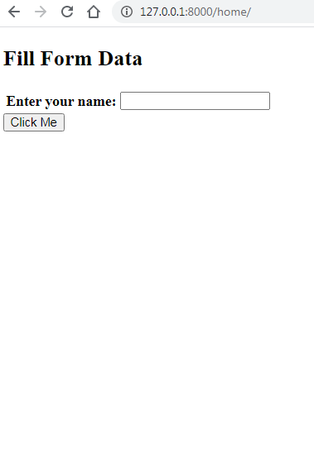
Output

Slide 8
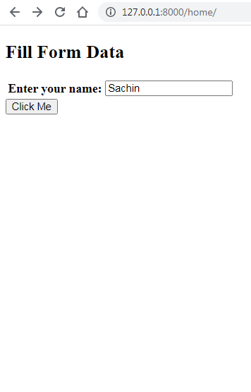
Output

Slide 9
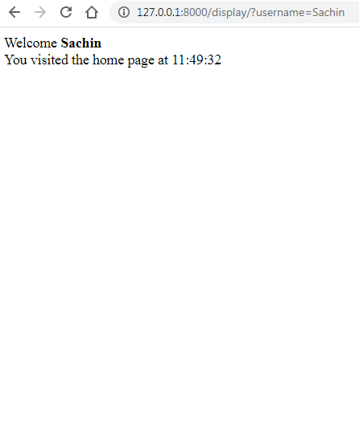
Output

Slide 10
Initial Setup
As usual we will design a project followed by an app called sessionapp.
After designing these essential components , there is another task we have to do!

Slide 11
Initial Setup
It is to perform migrations of default apps
This is because by default Django stores session data in database and unless we migrate the default apps this database will not be created

Slide 12
forms.py
from django import forms
class ShowForm(forms.Form):
username = forms.CharField(label='Enter your name')

Slide 13
views.py
from django.shortcuts import render
from sessionapp import forms
from datetime import datetime
def showinputform(request):
accesstime=datetime.now().strftime("%H:%M:%S")
request.session['accesstime'] = accesstime
frm = forms.ShowForm()
return render(request, 'sessionapp/home.html', {'form': frm})

Slide 14
views.py
def displayformdata(request):
accesstime = request.session['accesstime']
username = request.GET['username']
context={'at':accesstime,'un':username}
return render(request, 'sessionapp/response.html', context)

Slide 15
home.html
<!DOCTYPE html>
<html lang="en">
<head>
<title>Show Form</title>
</head>
<body>
<h2>Fill Form Data</h2>
<form action="/display/" method="get">
<table>
{{ form }}
</table>
<input type="submit" value="Click Me"/>
</form>
</body>
</html>

Slide 16
response.html
<!DOCTYPE html>
<html lang="en">
<head>
<meta charset="UTF-8">
<meta name="viewport" content="width=device-width, initial-scale=1.0">
<title>Show Form</title>
</head>
<body>
Welcome <strong> {{ un }} </strong> <br>
You visited the home page at {{ at }}
</body>
</html>

Slide 17
Most Important Point!
Here comes one of the most important thing we need to remember while using sessions:
Django saves the session data into the database only when it is modified.

Slide 18
What Is Modify ?
By modified, Django means following actions:
Adding new key-value pair to request.session dictionary.
item_list = { 'eggs': '10', 'apples': '20' , 'mango': '30' }
request.session['newkey'] = 'newval'
request.session['items_to_buy'] = item_list

Slide 19
What Is Modify ?
Changing the value of an existing key.
request.session['newkey'] = 'newval100'
Deleting the a key-value pair.
del request.session['newkey']

Slide 20
What Is Not Considered Modification ?
But, the following is not a modification.
request.session['items_to_buy']['eggs'] = '100'
Can you guess why ?
Here we are not modifying request.session dictionary instead we are modifying request.session['items_to_buy'].
If we want Django to save these changes to the database, then we will have to set modified attribute of session object to True.
request.session.modified = True

Slide 21
Changing It Permanently
To change this default behavior permanently, set SESSION_SAVE_EVERY_REQUEST to True in settings.py.
When SESSION_SAVE_EVERY_REQUEST is set to True then Django will save session data to the database on every request, even if you don't modify session data at all.

Slide 22
Setting Cookie Expiration Time
We can control session cookies expiration time by setting the following two variables in settings.py file:
Variable Name | Explanation
SESSION_COOKIE_AGE | This variable is used to set cookie expiration time in seconds. By default, it is set to 1209600 seconds or 2 weeks. If SESSION_EXPIRE_AT_BROWSER_CLOSE is not set then Django uses this variable to set cookie expiration time. Here is how you can set session cookie expiration time to 5 days: SESSION_COOKIE_AGE = 3600*24*5
SESSION_EXPIRE_AT_BROWSER_CLOSE | This variable controls whether to expire the session cookie when the user closes the browser. By default, it is set to False. If set to True, session cookie lasts until the browser is closed, irrespective of the value of SESSION_COOKIE_AGE.

